Slide 1
THE FINISHING SCHOOL THE ENGLISH AND FOREIGN LANGUAGES UNIVERSITY, HYDERABAD
Director: Prof. Amith Kumar P V
Coordinator: Dr. Vinay kumar Gupta

Slide 2
AIMS AND OBJECTIVES
The Finishing School is being established in the English and Foreign Languages University, Hyderabad with an intention to train and improve the communication skills, etiquette and mannerism, leadership qualities and personality development of students who would be graduating from the university.
The chief concern of the School is to channelize students’ energy levels towards attaining proficiency in linguistic articulation, expert life management, graceful social behaviour, meticulous career planning, and developing a strong environment consciousness.
The School provides an opportunity to refine the various aspects of the student’s personality so that s/he will be in a position to achieve maximum returns in the outer world.

Slide 3
AIMS AND OBJECTIVES
I. Articulation and Soft skills:
1. To improve interpersonal and communication skills of the students.
2. To focus on the improvement of Reading, Listening, Speaking and Writing [RLSW] skills.
3. To improve vocabulary and lexicographical skills.
4. To develop effective writing skills with a special focus on market oriented writing requirements.

Slide 4
AIMS AND OBJECTIVES
II. Personality Development and Life Skills:
1. To focus on developing assertiveness, equanimity, perseverance and motivation of students
2. To teach effective career planning and management
3. To enhance decision making, problem solving, and stress managing strategies.
4. To develop critical and creative thinking capabilities

Slide 5
AIMS AND OBJECTIVES
III. Cross - Cultural Sensitivity and Courteous Behaviour:
1. To train students concerning cultural etiquette, forms of politeness and social deportment.
2. To educate students with respect to civil affability and refined gentility.
3. To train students with respect to social intelligence and gelotology
4. To develop networking etiquette and interpersonal management

Slide 6
AIMS AND OBJECTIVES
IV. Environment Consciousness and Social Responsibility:
1. To improve a positive outlook towards respecting one’s environment and maintaining green sorroundings
2. Human values and social responsibility

Slide 7
INAUGURATION of the FINISHING SCHOOL (22nd March, 2018)

Slide 8
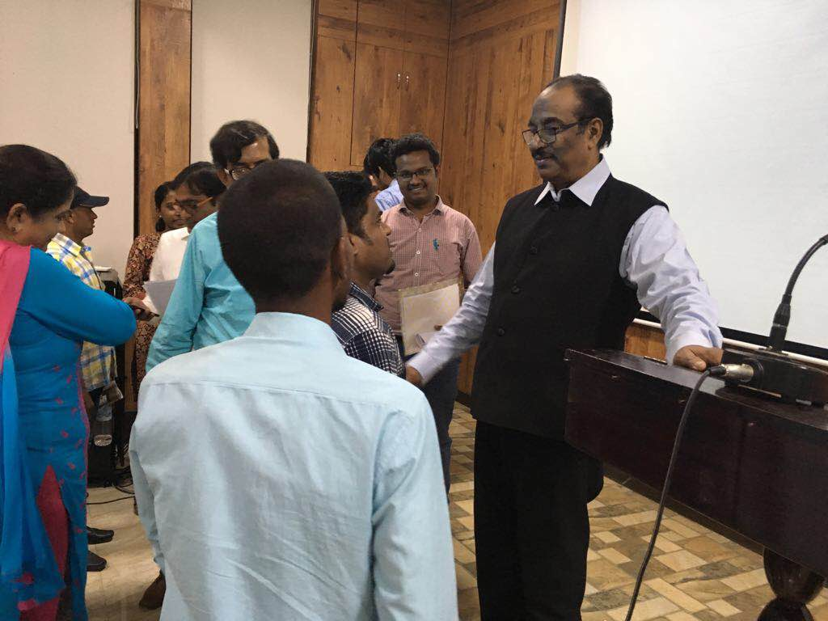
TALK -1 (22nd March, 2018) by B V PATTABHIRAM “HARNESSING SOFT SKILLS: A KEY REQUIREMENT FOR SUCCESS”

Slide 9
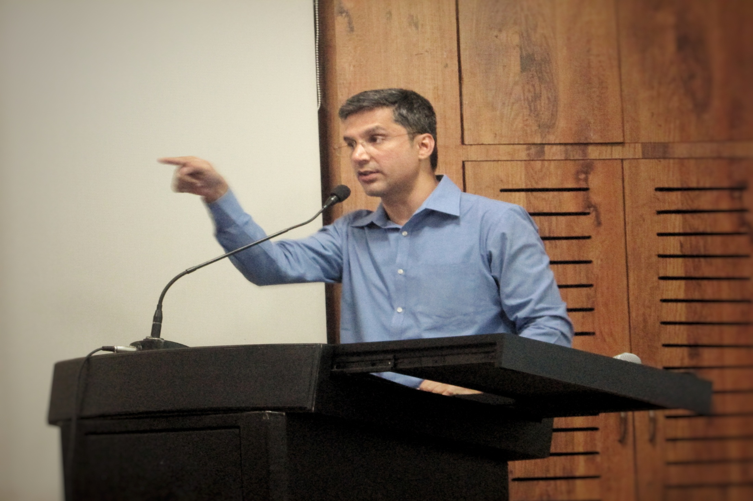
TALK -2 (26th March, 2018) by VENKATA KRISHNA R “How to Ace the Interview?”

Slide 11
TALK -3 (11TH April, 2018) by G V N RAJU “PRESENTATION SKILLS: THE SIGNIFICANCE OF ORAL COMMUNICATION”

Slide 13
Student Attendance and Feedback
Talk -1 was attended by 120 students
Talk -2 was attended by 80 students
Talk -3 was attended by 70 students
82 students have enrolled to participate in the activities of the Finishing School till now
A seven-member student volunteer committee has been constituted to help the Director and the Coordinator in organizing the talks.
Feedback received is very positive and encouraging
Students want more activities and talks from the Finishing School.

Slide 14
FUTURE ACTIVITIES
A five-day intensive training programme on communication skills in August 2018.
A three-day training programme on Public Speaking in September.
A four day training programme on Life Skills and Personality Development in October.
A three-day workshop on Etiquette and Cultural Sensitivity in November.

Slide 15
THANK YOU

